Slide 1
Enterprise Data Warehouse Development

Slide 2
Data Warehouse
Data warehouse (DW) is a pool of data produced to support decision making; it is also a repository of current and historical data of potential interest to managers throughout the organization.
A Data warehouse is typically used to connect and analyze business data from heterogeneous sources. The data warehouse is the core of the BI system which is built for data analysis and reporting. It is a blend of technologies and components which aids the strategic use of data

Slide 3
Data Integration
As data warehouses grow in size, the issues of integrating data grow as well
Data integration comprises three major processes that, when correctly implemented, permit data to be accessed and made accessible to an array of ETL and analysis tools and the data warehousing environment:
data access (i.e., the ability to access and extract data from any data source),
data federation (i.e., the integration of business views across multiple data stores), and
change capture (based on the identification, capture, and delivery of the changes made to enterprise data sources).

Slide 4
Data Integration(2)
A major purpose of a data warehouse is to integrate data from multiple systems Various integration technologies enable data and metadata integration:
Enterprise application integration (EAI)
Service-oriented architecture (SOA)
Enterprise information integration (EII)
Extraction, transformation, and load (ETL)

Slide 5
Enterprise application integration (EAI)
Enterprise application integration (EAI) provides a vehicle for pushing data from source systems into the data warehouse.
It involves integrating application functionality and is focused on sharing functionality (rather than data) across systems, thereby enabling flexibility and reuse.

Slide 6
Service-oriented architecture (SOA)
SOA or Service Oriented Architecture is a term that is becoming a trend in the latest technology in the IT world. Referring to the name Service Oriented Architecture is an approach in designing (architect) systems where the services that exist in each existing system.

Slide 7
Enterprise information integration (EII)
Enterprise information integration (EII) is an evolving tool space that promises real-time data integration from a variety of sources, such as relational databases, Web services, and multidimensional databases.
It is a mechanism for pulling data from source systems to satisfy a request for information.

Slide 8
Extract Transform and Load Process
Extraction, transformation, and load (ETL) technologies, which have existed for some time, are instrumental in the process and use of data warehouses.
The ETL process is an integral component in any data-centric project.

Slide 9
Data Warehouse Benefit
A data warehouse provides several benefits that can be classified as direct and indirect. Direct benefits include the following:
End users can perform extensive analysis in numerous ways.
A consolidated view of corporate data (i.e., a single version of the truth) is possible.
Better and more timely information is possible.
Enhanced system performance can result.
Data access is simplified.

Slide 10
Data Warehouse Development approaches
Top-down
Bottom-up
Adapts traditional relational database tools to the development needs of an enterprise-wide data warehouse, also known as the EDW approach (Bill Inmon)
Employs dimensional modeling, also known as the DM approach (Ralph Kimball)

Slide 11
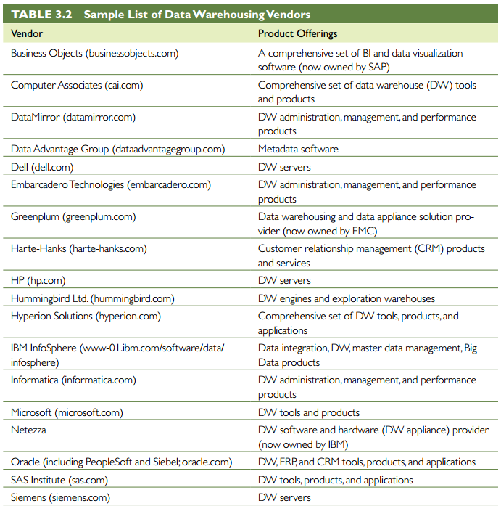
Data Warehouse vendor

Slide 12
The Inmon Model
The Inmon Model - The EDW Model:
Inmon’s approach emphasizes top-down development, employing established database development methodologies and tools, such as entity-relationship diagrams (ERD) and an adjustment of the spiral development approach.

Slide 13
The Kimball Model
The Kimball Model: The Data Mart Approach Kimball’s DM Strategy Is A “Plan big, build small” approach.
A DM is a subject-oriented or department-oriented data warehouse.
It is a scaled-down version of a data warehouse that focuses on the requests of a specific department, such as marketing or sales

Slide 14
DM VS EDM

Slide 15
Which Model Is Best?
There Is No One-size-fits-all strategy to data warehousing.
An enterprise’s data warehousing strategy can evolve from a simple DM to a complex data warehouse in response to user demands, the enterprise’s business requirements, and the enterprise’s maturity in managing its data resources

Slide 16
Dimensional Modeling
Dimensional modeling is a retrieval-based system that supports high-volume query access.
Representation and storage of data in a data warehouse should be designed in such a way that not only accommodates but also boosts the processing of complex multidimensional queries.

Slide 17
Star vs Snowflake Schema

Slide 18
Star Schema
The star schema (sometimes referenced as star join schema) is the most commonly used and the simplest style of dimensional modeling.
A star schema contains a central fact table surrounded by and connected to several dimension tables (Adamson, 2009).
Surrounding the central fact tables (and linked via foreign keys) are dimension tables.
The dimension tables contain classification and aggregation information about the central fact rows.
Dimension tables contain attributes that describe the data contained within the fact table; they address how data will be analyzed and summarized.
Dimension tables have a one-to-many relationship with rows in the central fact table.

Slide 19
Snowflake Schema
Snowflake schema is a logical arrangement of tables in a multidimensional database in such a way that the entity-relationship diagram resembles a snowflake in shape. the snowflake schema is represented by centralized fact tables (usually only one), which are connected to multiple dimensions. Dimensions are normalized into multiple related tables

Slide 20
Analysis of Data in Data Warehouse
Once the data is properly stored in a data warehouse, it can be used in various ways to support organizational decision making.
OLAP is an approach to quickly answer ad hoc questions by executing multidimensional analytical queries against organizational data repositories (i.e., data warehouses, DMs).

Slide 21
OLAP vs OLTP
OLTP is a term used for a transaction system that is primarily responsible for capturing and storing data related to day-to-day business functions such as ERP, CRM, SCM, POS, and so forth
OLAP, on the other hand, is designed to address this need by providing ad hoc analysis of organizational data much more effectively and efficiently.
OLAP uses the data captured by OLTP, and OLTP automates the business processes that are manage

Slide 22
OLAP Operations
Slice. A slice is a subset of a multidimensional array (usually a two-dimensional representation) corresponding to a single value set for one (or more) of the dimensions not in the subset.
Dice. The dice operation is a slice on more than two dimensions of a data cube.
Drill Down/Up. Drilling down or up is a specific OLAP technique whereby the user navigates among levels of data ranging from the most summarized (up) to the most detailed (down).
Roll-up. A roll-up involves computing all the data relationships for one or more dimensions. To do this, a computational relationship or formula might be defined.
Pivot. This is used to change the dimensional orientation of a report or ad hoc query-page display

Slide 23
Data Warehousing Implementation Issues
When developing a successful data warehouse, it is importantto carefully consider various risks and avoid the following issues
Engaging in politically naive behavior.
Loading the warehouse with information just because it is available
Believing that data warehousing database design is the same as transactional database design
Choosing a data warehouse manager who is technology oriented rather than user Oriented
Focusing on traditional internal record-oriented data and ignoring the value of external data and of text, images, and, perhaps, sound and video

Slide 24
Data Warehousing Implementation Issues (1)
Delivering data with overlapping and confusing definitions
Believing promises of performance, capacity, and scalability
Believing that your problems are over when the data warehouse is up and running.
Focusing on ad hoc data mining and periodic reporting instead of alerts

Slide 25
Data Warehousing Implementation Issues (2)
A data warehouse will be successful only if there is strong senior management support for its development and if there is a project champion who is high up in the organizational chart.
User participation in the development of data and access modeling is a critical success factor in data warehouse development.
During data modeling, expertise is required to determine:
what data are needed,
define business rules associated with the data, and
decide what aggregations and other calculations may be necessary.

Slide 26
Massive Data Warehouses and Scalability
The main issues pertaining to scalability are:
the amount of data in the warehouse
how quickly the warehouse is expected to grow
the number of concurrent users
the complexity of user queries

Slide 27
Massive Data Warehouses and Scalability(1)
A data warehouse must scale both horizontally and vertically.
Data growth may be a result of the addition of current cycle data (e.g., this month’s results) and/or historical data
Given that the size of data warehouses is expanding at an exponential rate, scalability is an important issue.
Good scalability means that queries and other data-access functions will grow (ideally) linearly with the size of the warehouse.
Scalability is difficult when managing hundreds of terabytes or more.
Terabytes of data have considerable inertia, occupy a lot of physical space, and require powerful computers

